Slide 1

“COUNTERING COVID-19 ON UNIVERSITY OF PESHAWAR CAMPUS IN PAKISTAN”
PRESENTATION IN INETRNATIONAL WEBINAR ON, “ FIGHTING AGAINST COVID-19 IN CAMPUS” ORGANISED BY , S&SE ASIAN UN, YUNNAN UNIVERSITY, CHINA ON 20TH MAY 2020.
By
PROF DR ZAHID ANWAR,
Director, China Study center, University of Peshawar &
UOP Focal Person for CPEC China Pakistan Universities Consortium,
zahid_anwar@uop.edu.pk wechat: hizahid

Slide 2



Slide 3
THANKS TO
South &South East Asian Universities Network and Yunnan University for organizing this online webinar on, “fighting COVID-19 on campus” and giving me an opportunity to share my views with the learned participants of this webinar.
I consider it indeed an honour and privilege

Slide 4
INTRODUCTION
Since time memorial humanity has faced natural disasters including infectious diseases.
Historical record show that in 14th Century black plague infected millions of human beings and in 1918 flue pandemic killed millions of people
Recently Severe Acute Respiratory Syndrome (SARS) in 2002 and Middle East Respiratory Syndrome (MERS) in 2012 have infected many people in different countries.

Slide 5
COUNTERING COVID-19 IN CHINA
In Wuhan, China in late 2019 a new corona virus caused highly infectious illness which doctors termed COVID-19.
Chinese scientists identified the whole genome sequence of this Novel Corona Virus within a short time and saved millions of people from COVID

Slide 6
To overcome the epidemic China implemented the principle of “four concentrations” i.e., concentration of patients, specialists, resources and treatment
and has adopted the strategy of “four earlies” i.e., early detection, early reporting, early quarantine and early treatment.

Slide 7
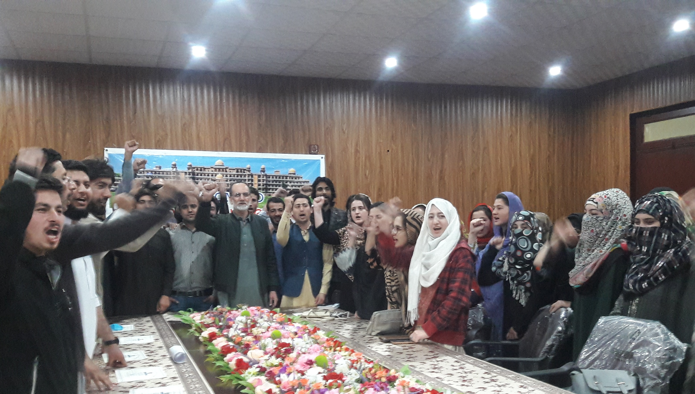
China Study Center UOP organized a program of faculty and students to show solidarity with people of Wuhan.

Slide 8
COUNTERING COVID IN PAKISTAN
China and Pakistan helped each other in all weathers. When COVID epidemic broke out in China the President of Pakistan visited China to show solidarity with China.
When COVID spread in Pakistan, China gave solid support to Pakistan against COVID.
Teams of doctors came to Pakistan to help in the fight against COVID which was very much appreciated by people of Pakistan

Slide 9
COUNTERING COVID IN PAKISTAN
China Embassy Islamabad played proactive role during the pandemic and coordinated China support to Pakistan in a well organized way.
When the epidemic transformed into pandemic Pakistan adopted measures to cope with the situation.
Quarantine Centers were established in different parts of the country.

Slide 10
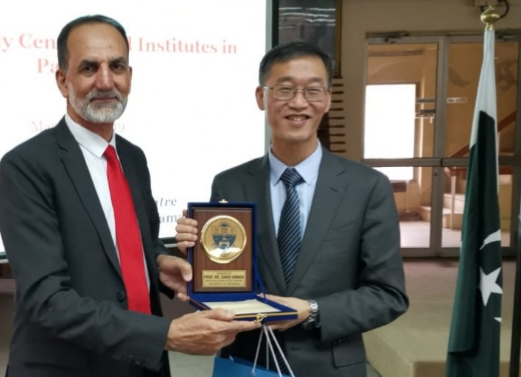
H. E. YAO JING, CHINA AMBASSADOR TO PAKISTAN

Slide 11
Print, electronic and social media contributed a lot to help people against COVID.
In mobile phones ring tones were replaced with message about protection from COVID-19.
Online daily updates help to know the situation in Pakistan

Slide 12
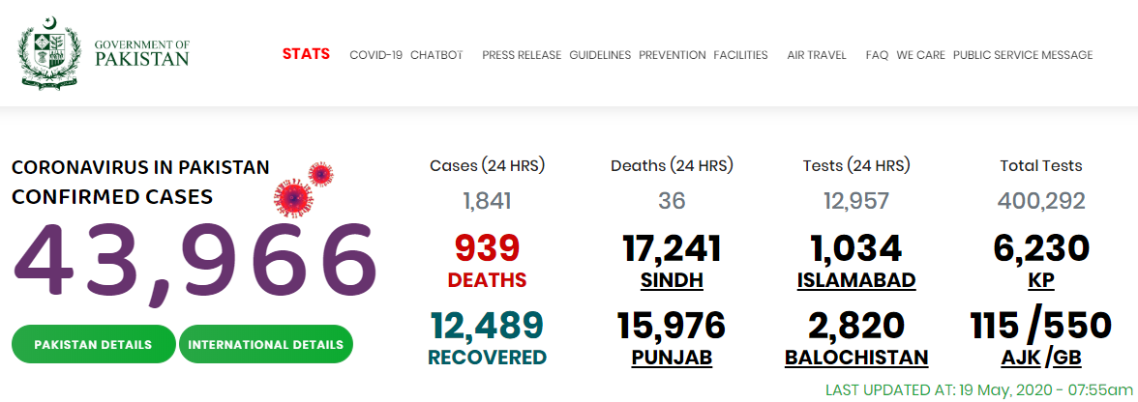

Slide 13
COUNTERING COVID IN PAKISTAN
When Pakistani citizens returned from abroad COVID spread in Pakisn.
Lockdown was enforced for public safety.
Rs. 12000 per head were given to labourers working on daily wages.
A tiger force of young volunteers was formed to help needy people.
Doctors online service was started to provide free of cost advice to people.

Slide 14
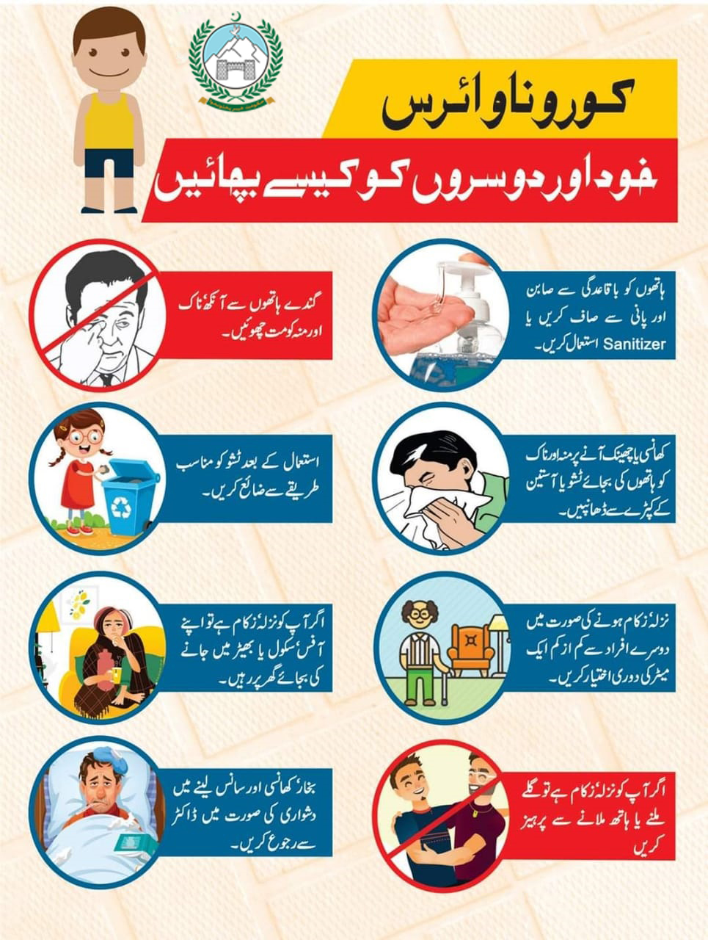

Slide 15

HOSPITALS IN KP PROVINCE OF PAKISTAN

Slide 16
FIGHTING COVID ON UOP CAMPUS
There are four Universities on the same campus: 1 university of Peshawar, University of Engineering and Technology, Agriculture University Peshawar and Islamia College University Peshawar. There are 10 universities within radius of 20 KM in Peshawar.
They are Gandhara University, Qurtaba University, City University, Sarhad University, Brains University and BBS Women University.

Slide 17
Federal and provincial Governments guidelines were followed by the residents on campus.
Coordination mechanism was developed between University administration, district administration and provincial government to cope with any eventuality.
Three hostels which were vacated after University closure in March were transformed into quarantine Centers

Slide 18
University of Peshawar organized many online meetings to explore ways and means to educate administration, faculty and students about the COVID-19 Pandemic.
The use of face masks and gloves advised and social distancing became the norm of the daily life.
China Study Center, University of Peshawar collaborated with CIIS, UIBE,SIIS and Yunnan University against COVID-19

Slide 19
University of Peshawar in collaboration with XJTU and HEC organized an online conference on 7th May 2020 on “ Fighting COVID-19: Arrangements and Measures” in which many experts shared their presentations

Slide 20
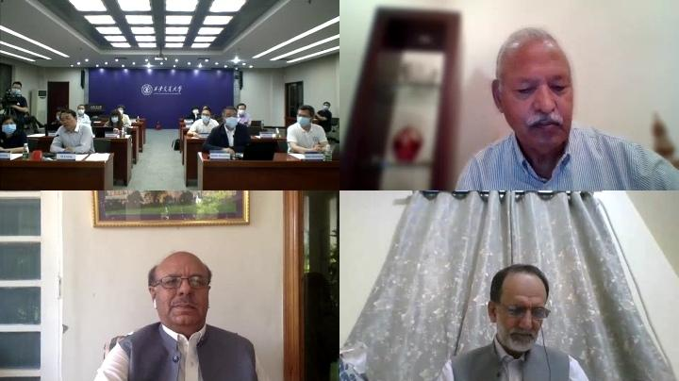
TELECONFERENCE BETWEEN XJTU & UOP AGAINST COVID

Slide 21
University of Peshawar strengthened contacts with GUIZHOU University during the pandemic and Guizhou University donated face masks, gloves and other necessary equipments to UOP which were appreciated by the residents of UOP.

Slide 22

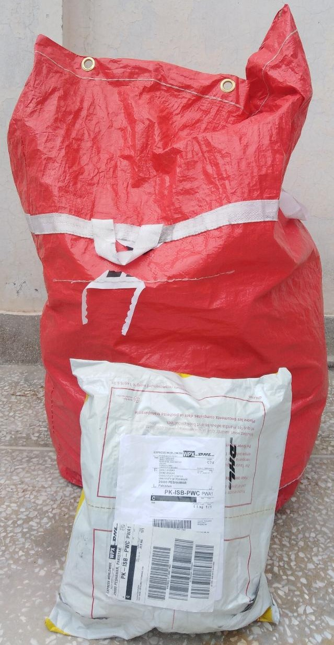
GUIZHOU UNIVERSITY MASKS AND GLOVES FOR UOP

Slide 23
COVID-19 affected UOP also. A cashier of a bank located on campus infected with COVID and then died.

Slide 24
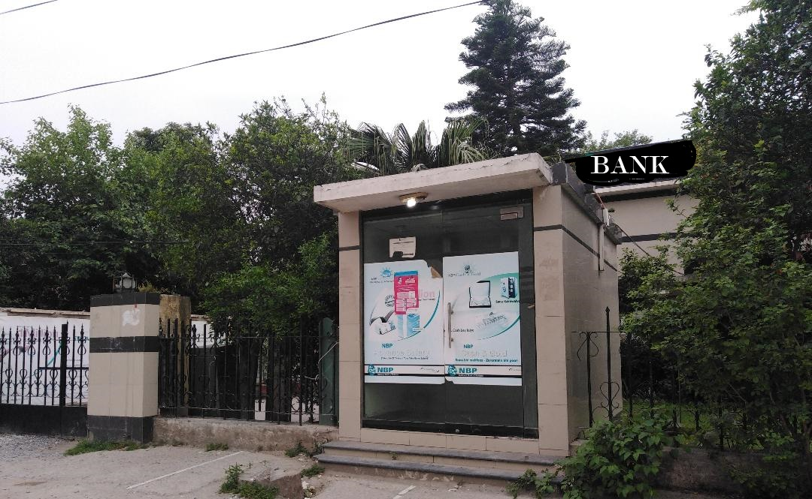
BANK & ATM MACHINE TEMPORARLY CLOSED

Slide 25
A vegetables shop owner along with his brother on campus infected with COVID and bothe were quarantined.
The nearby shops were closed and the whole neighbourhood was advised to remain confined to their homes.

Slide 26
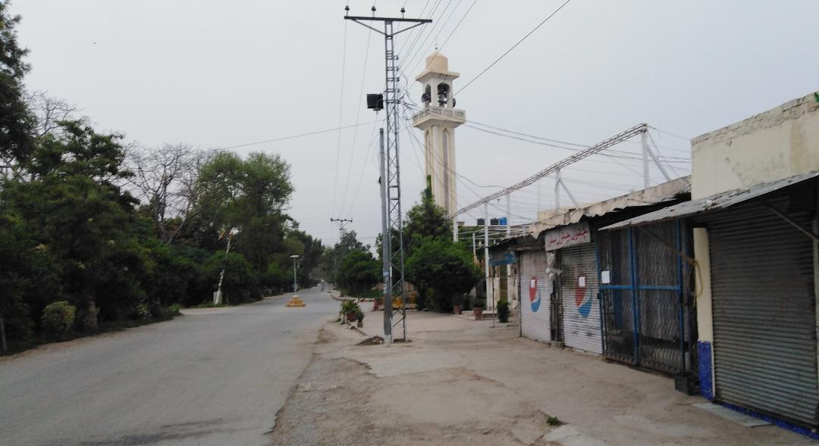
SHOPKEEPER OF A VEGETABLE SHOP GOT INFECTED

Slide 27
All residents on campus were advised to offer their daily payers in their homes and follow the social distancing principles.
Large gathering at wedding and funeral were discouraged on campus.
The UOP was closed and students were sent to their hometowns.
Examinations were rescheduled.
These measures helped a lot to contain the infectious disease on campus.

Slide 28
UOP is one of the oldest University of Pakistan and the oldest University of the province.
It has started online teaching at graduate and postgraduate level
Its Center for Disaster Preparedness and Management egaged its faculty and students to explore ways and means to help.
Its Center for Biotechnology and Microbiology strengthened its collaboration with Chinese counterparts.

Slide 29
GLOBAL SOLIDARITY AGAINST COVID
An International cooperative vision and program is required to cope COVID and the political and economic mayhem which it will unleash in its wake.
The viruses that cause infectious diseases do not respect political border, age, ethnicity and class of people.
The world requires unity than stigma, science than rumors and facts than fear to address the problem of novel corona virus.

Slide 30
Against this contagious pathogen all people are waves of the same ocean, buds of the same orchard and branches of the same tree.
G20 made a commitment to inject more than $5 trillion into the global economy and all members agreed that solidarity and cooperation is prerequisite to overcome this pandemic.
Without any shadow of doubt this is a good development.

Slide 31
The people of South and South East Asia swim and sink together.
University of Peshawar is grateful to S&SE ASIAN UNIVERSITIES NETWORK especially Yunnan University for organizing this online webinar on countering COVID on Campuses.
It welcome and will cooperate and contribute to any collective effort / project proposed by S&SE ASIAN UN to defeat COVID19.

Slide 32
